Slide 1
Generative Adversarial Networks for Time Series
Autonomous Multisensor Systems Group
Institute for Intelligent Cooperating Systems
Faculty of Computer Science
Otto von Guericke University, Magdeburg
02.05.2024
Team Members: Archana Yadav, Gowtham Premkumar, Shweta Bambal

Slide 2
Contents
Introduction
Types of Time-GAN
Transformer Based Time-GAN
TCGAN - Convolutional GAN for Time Series
Recurrent Conditional GANs
Project Timeline
References

Slide 3
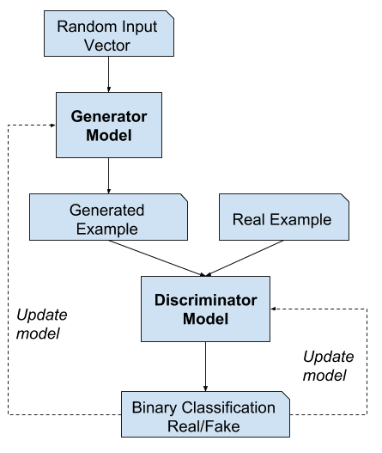
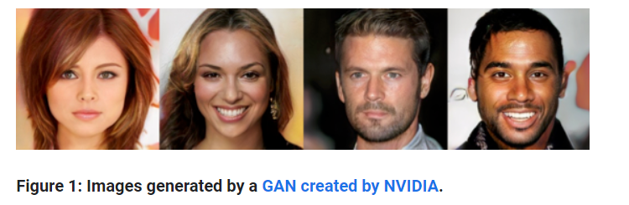
Introduction
Generative Adversarial Networks (GANs) are made up of two neural networks, a discriminator and a generator. They use adversarial training to produce artificial data that is identical to actual data.
https://machinelearningmastery.com/what-are-generative-adversarial-networks-gans/

Slide 4
Transformer Based Time-GAN
A transformer-based GAN model designed to generate synthetic time-series data.
Utilizes a pure transformer encoder architecture for both the generator and discriminator networks.
Time-series data is represented as a matrix by treating a time-series sequence as an image with a height of 1
Each time-series sequence is represented as a matrix with the size (BatchSize, C, 1, W)
C is the number of channels in the time-series data, analogous to the RGB channels in an image.
W is the number of timesteps, similar to the width of an image
Handling Long Sequences
Data Augmentation
Advantages
Complexity
Interpretability
Disadvantages

Slide 5
TCGAN - Convolutional GAN for Time Series
Incorporates convolutional neural networks to capture spatial hierarchies and temporal dynamics.
Training Methodology : Combines traditional adversarial loss with a novel time-series-specific loss.
Performance Evaluation : Demonstrates superior performance in generating realistic sequences with intricate time dependencies.
Applications : requiring detailed sequential data analysis like finance and healthcare, synthetic stock market data, Produces realistic patient monitoring data for developing predictive healthcare models.
Scalability
Enhanced Feature Learning
Efficiency in Training
Advantages
Complexity
Prone to Overfitting
Dependency on Large Datasets
Disadvantages

Slide 6
REAL-VALUED (MEDICAL) TIME SERIES GENERATION WITH RECURRENT CONDITIONAL GANS
Training Methodology : Utilizes recurrent neural networks (RNNs) in both the generator and discriminator of the GAN12.
Performance Evaluation :Novel evaluation methods are introduced, including generating synthetic datasets and assessing model performance on real test data (TSTR method).
Applications : Aimed at generating synthetic medical data that can be shared without privacy concerns, potentially augmenting real datasets
Can generate realistic time-series data useful for supervised training.
Offers a way to create synthetic medical datasets for research without compromising patient privacy.
Advantages
The complexity of medical data makes it challenging to ensure the synthetic data’s utility and privacy.
Disadvantages

Slide 7
Project Timeline
Project Phase | Apr-24 |  | May-24 |  |  |  | Jun-24 |  |  |  | Jul-24 |  |  |  | Aug-24
 | W3 | W4 | W1 | W2 | W3 | W4 | W1 | W2 | W3 | W4 | W1 | W2 | W3 | W4 | W1 | W2 | W3 | W4
Literature review
Research Paper Gathering
Summarizing LR
First Report Draft
Deciding Implementation Method
Implementation
Evaluation of Performance
Second Draft
Final Report Writing
Final Draft
Review and Submission

Slide 8
References
https://www.geeksforgeeks.org/generative-adversarial-network-gan/
Li, X., Metsis, V., Wang, H., Ngu, A.H.H. (2022). TTS-GAN: A Transformer-Based Time-Series Generative Adversarial Network. In: Michalowski, M., Abidi, S.S.R., Abidi, S. (eds) Artificial Intelligence in Medicine. AIME 2022. Lecture Notes in Computer Science(), vol 13263. Springer, Cham. https://doi.org/10.1007/978-3-031-09342-5_13

Slide 9
Generative Adversarial Networks for Time Series
Thank You For Your Attention!

